Slide 1
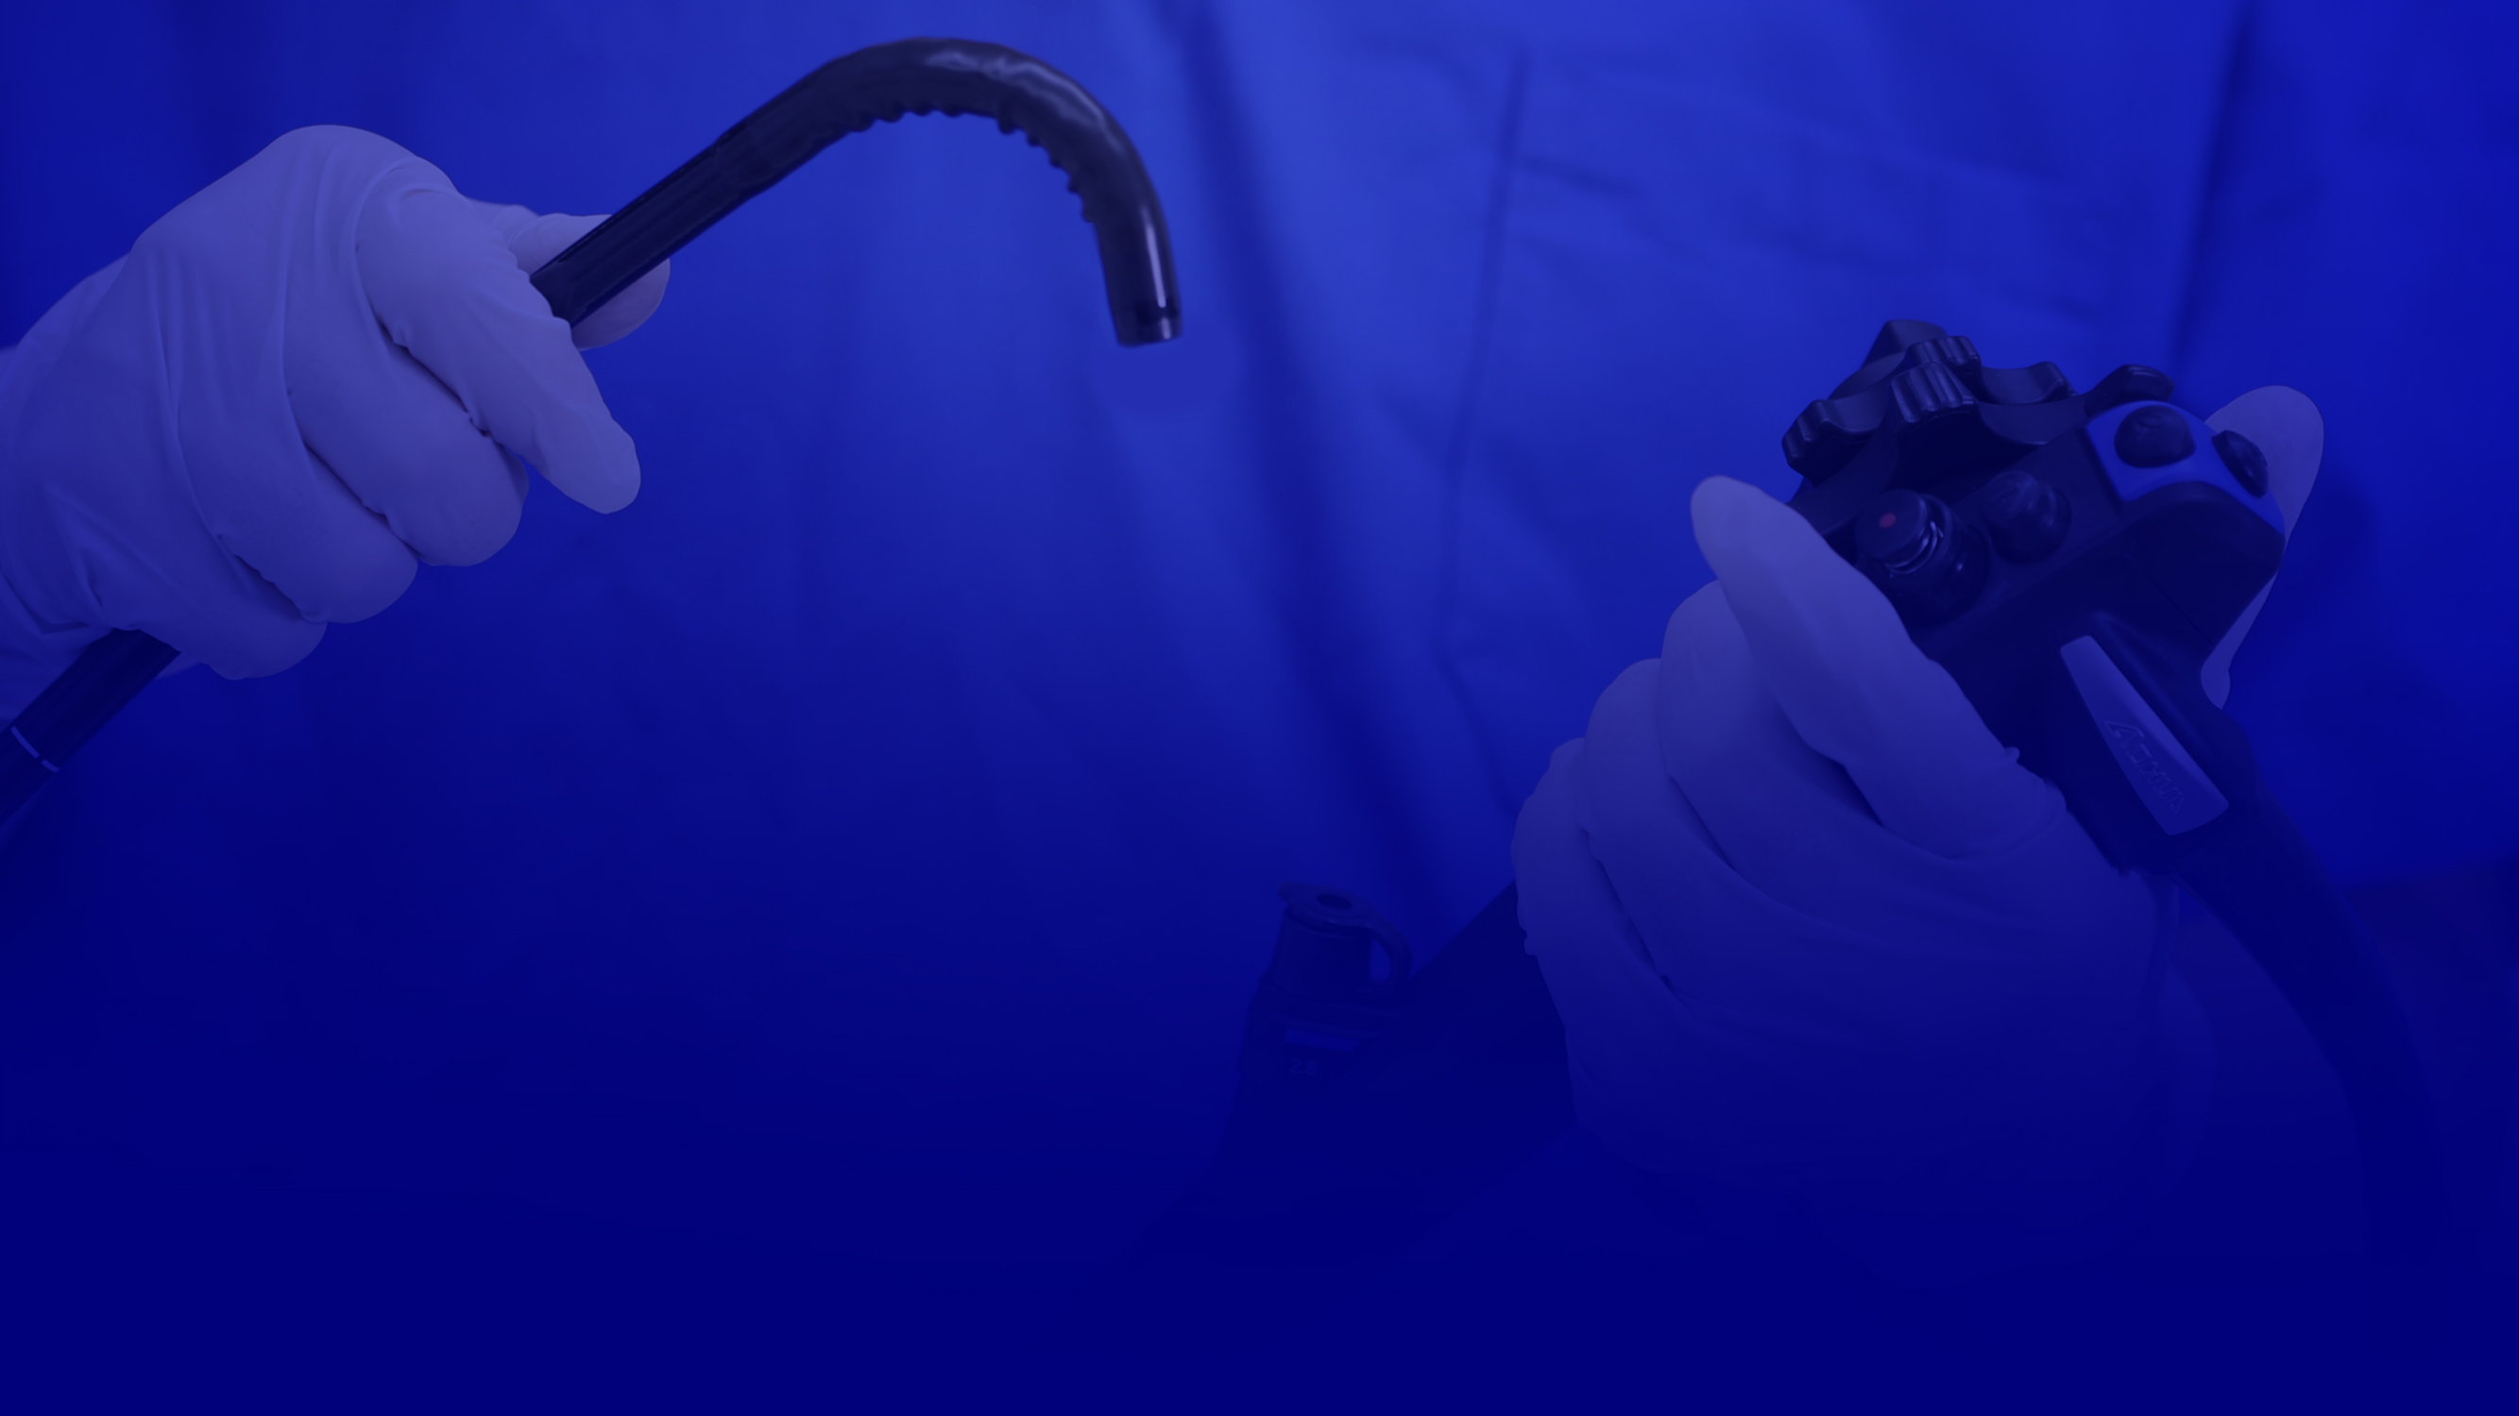
- Introduction to OR-100 -
AOHUA ENDOSCOPY CO., LTD.
Copyright©1994-2023 Aohua Endoscopy Co., Ltd. All Rights Reserved.

Slide 2
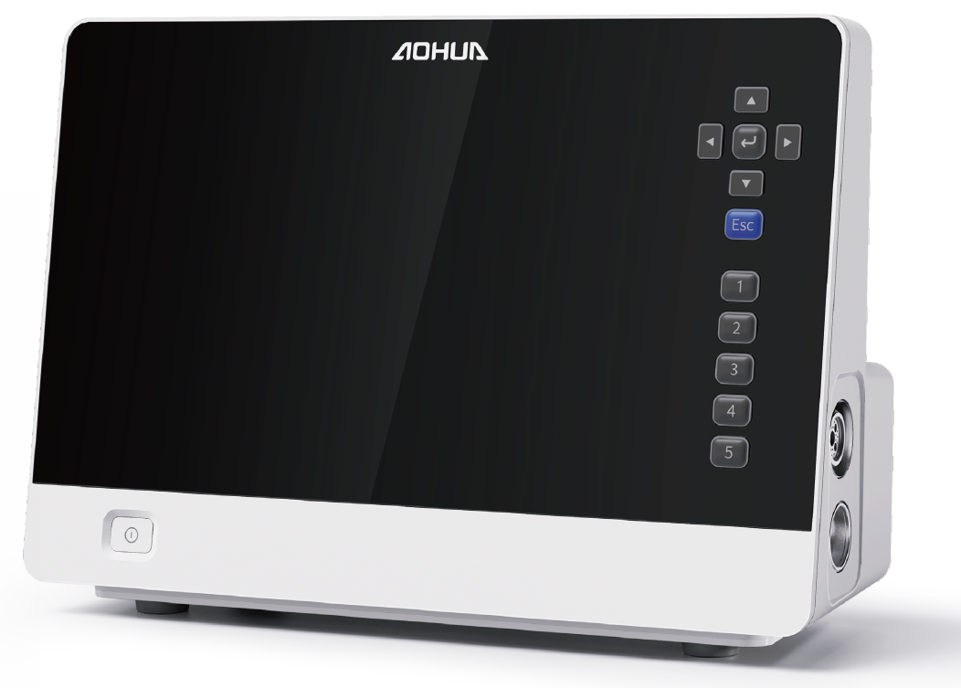
- OR-100 Full HD Endoscopy System -
15.6” full HD screen
Action button
Socket for both
flexible & rigid endoscope
Power switch
Intelligent LED light source
White balance panel

Slide 3
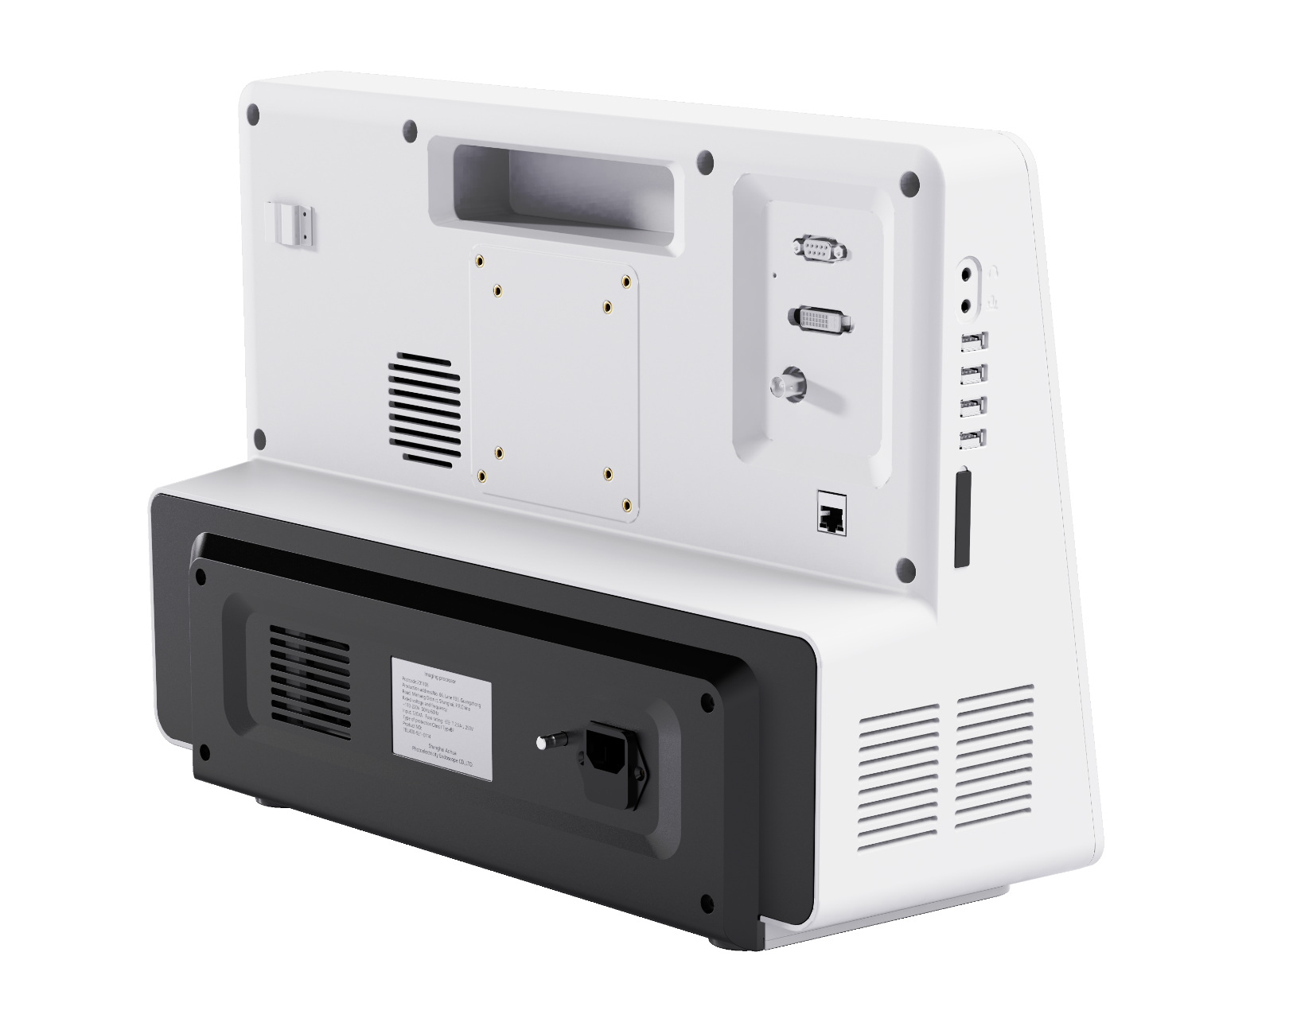
- OR-100 Full HD Endoscopy System -
DVI & OPTION socket
Water bottle holder
Headphone socket
USB socket
Network cable socket
SD card slot
Air pump
Power cord socket

Slide 4
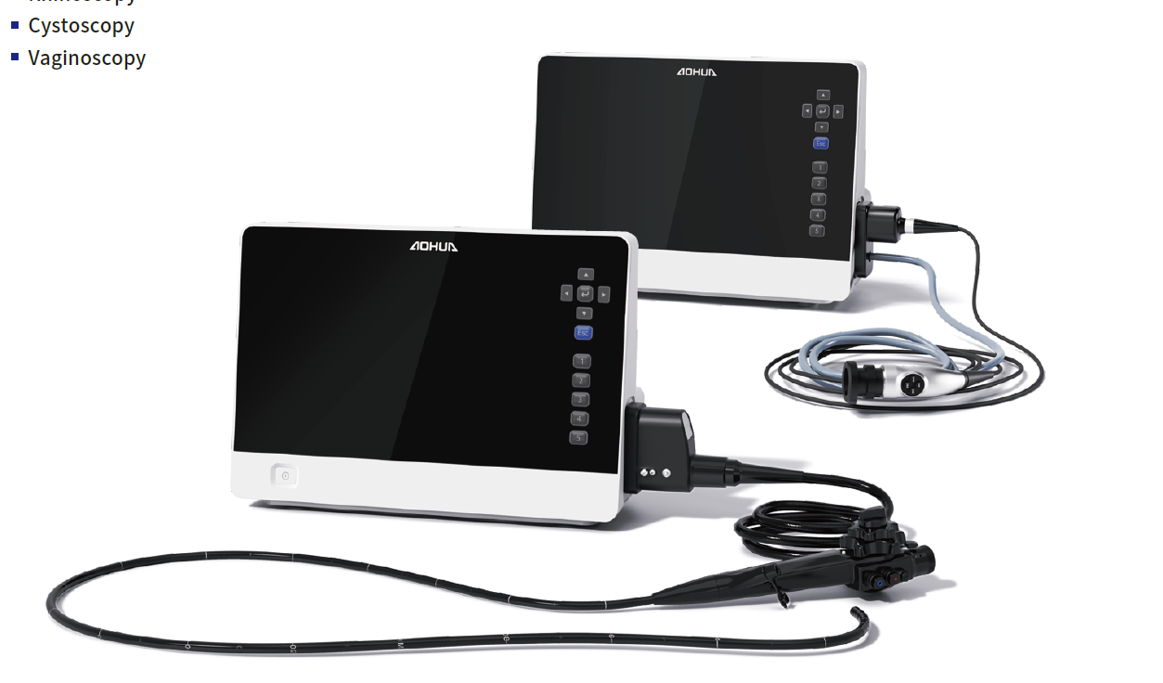
- OR-100 Full HD Endoscopy System -
OR-100 is an all-in-one system that combines a full HD image processor for both flexible and rigid endoscopes, a 15.6” full HD screen monitor, LED light source, and air pump.
This system provides high-quality imaging and visualization capabilities that aid in the diagnosis and treatment of a wide range of conditions in animals.
With this system, veterinarians can perform endoscopic procedures with high-quality imaging and visualization, making it easier to identify and treat various conditions.

Slide 5
- How to Produce Full HD Images -
Motus 4.0
OR-100 is equipped with a full HD dual-core platform, Motus 4.0, which can help the system to quickly and accurately process the image data captured by either flexible or rigid endoscope.
Motus
4.0

Slide 6
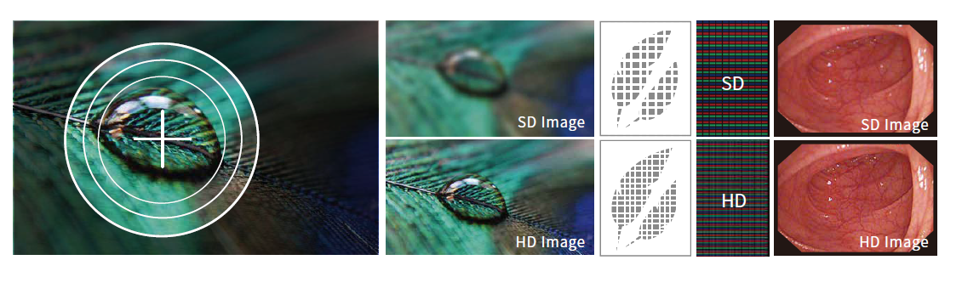
- How to Produce Full HD Images -
Full HD Screen Monitor
The 15.6" screen size of the monitor allows for a larger and more immersive viewing experience, which can provide bright and clear illumination of the endoscopic images, ensuring that even small details and structures are easily visible.
HD
HD Image
HD Image
Full HD
Full HD Image
Full HD Image

Slide 7
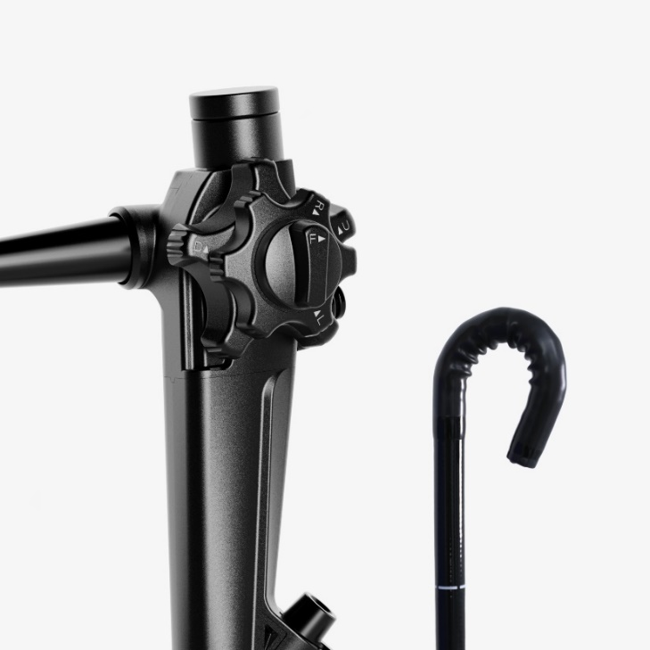
- How to Produce Full HD Images -
Full HD Flexible Video Endoscope
Aohua's first full HD flexible video endoscope “VET-FHD” series offers exceptional image quality that can facilitate easy diagnosis and treatment of animals. The high-definition images captured by the VET-FHD can provide veterinary professionals with a clearer view of internal structures, which can lead to more accurate diagnoses and better treatment outcomes.

Slide 8
- Improved Clinical Performance -
The LED light source of OR-100 provides consistent and uniform illumination, which is essential for accurate diagnosis and treatment. It can also be adjusted to different levels of brightness, depending on the specific requirements of the procedure. CBI can be used as a diagnostic tool during endoscopy to aid in the visualization and identification of abnormal tissue.
Image enhancement make it easier for users to obtain high-quality images without requiring manual adjustments. There are 3 models you can choose:
1) Edge enhancement, which enhances the sharpness of the image edges.
2) Structure enhancement, which enhances the visibility of vessels within the image
3) Composite enhancement, which enhances both the sharpness of edges and the visibility of vessels.

Slide 9
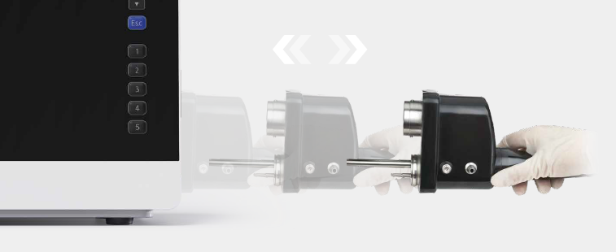
- Strong Compatibility -
Work with Both Flexible and Rigid Endoscopes, making it suitable for various veterinary applications. It can be used with all VET series flexible endoscopes, providing improved image performance for diagnostic and surgical procedures in veterinary medicine.
Hot-swappable capability allows for easy and convenient swapping of both flexible and rigid endoscopes.
Multiple Storage with USB storage and has an internal SD card slot for storing images and recordings.

Slide 10
- Manage Your Patient -
Patient report management system helps veterinarians easily manage patient information, with features like an on-screen keyboard. Patient information can be stored in individual folders. (under developing)
Network interface for direct connection to workstations and other systems, such as HIS/PACS, for importing and exporting patient data. (under developing)
Record both video and audio (the doctor's voice) by connecting an external microphone to the main unit, which is convenient for teaching and patient managing. (under developing)

Slide 11
- Humanization -
User presets allow you to save your own settings and apply them with just one click.
Reduce manual operations with features like automatic startup for the air pump and light source.
Auxiliary water inlet for washing away foreign bodies or cleaning wounds.

Slide 12
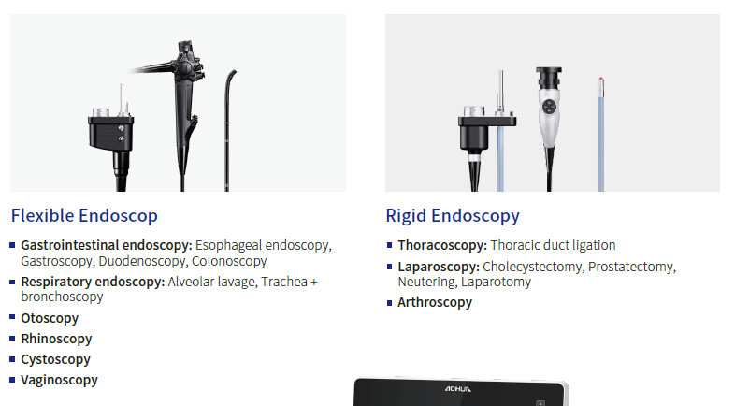
- Application -
Flexible Endoscopy
Rigid Endoscopy

Slide 13
THANKS
AOHUA ENDOSCOPY CO., LTD.
Copyright©1994-2023 Aohua Endoscopy Co., Ltd. All Rights Reserved.

